Slide 1
Introduction & Syllabus
<Adv C & App/>
Advanced C Programming
And It’s Application
Assistant Prof. Chan, Chun-Hsiang
Department of Artificial Intelligence, Tamkang University
Sep. 22, 2021
</Adv C & App >

Slide 2
大綱
<Outline/>
[1] 簡介
[2] 課程大綱
[3] 課程評量方式
C
</Outline>

Slide 3

簡介
<Intro/>
目前在職
兼任助理教授 | 淡江大學 人工智慧學系
博士後研究員 | 臺北醫學大學 醫學系 放射線學科
兼任資料科學家 | 中央研究院 社會學研究所
主要學歷
博士 | 國立臺灣大學 地理環境資源學系
碩士 | 國立臺灣大學 地理環境資源學系
碩士 | 實踐大學 食品營養與保健生技學系
學士 | 國立臺北教育大學 社會與區域發展學系
主要經歷
資料分析師 | 財團法人資訊工業策進會 資安科技研究所
實習生 | 行政法人國家災害防救科技中心 坡地組
兼任資料科學家 | 香港中文大學 新聞與傳播學院
研究助理 | 臺大地理系 地理計算科學研究室
研究助理 | 臺大地理系 遙測及空間知識實驗室
研究助理 | 國北社發系 土石流防災實驗室
</Intro>

Slide 4
學位論文
<Intro/>
博士論文
國立臺灣大學 | 地理環境資源學系
Characterizing Major Airline Alliances: A Network Analysis
碩士論文
國立臺灣大學 | 地理環境資源學系
Applying Ultra Low Frequency Remote Sensing Techniques in the Earthquake Precursor Analysis — Using Taiwan as an Example
實踐大學 | 食品營養與保健生技學系
Effects of Ultrasonic Treatment on Physical Properties and in vitro Digestibility of High Amylose Maize Starch
學士論文
國立臺灣大學 | 化學系
Ring-Opening Polymerization of ε-caprolactone Using Organoaluminum Complexes Bearing Amido-pyridine Bidentate Ligand
國立臺北教育大學 | 社會與區域發展學系
Establishing Debris-Flow Cluster and Modified Critical Rainfall Line
</Intro>

Slide 5
<Intro/>
Technical Skills
Computer Science: Python, Matlab, R, C#, JavaScript, jQuery, jQueryUI, Android Development, HTML, MySQL, Nodejs, AngularJS, MongoDB, Elasticsearch, Spark, Facebook APIs and Twitter APIs
Geography: GIS (ArcGIS, QGIS, Super GIS), Spatial Statistics, Spatial Database, Complex Network Analysis, Gephi
Physics: Signal Processing (in time sequence and frequency) and Electromagnetic Analysis
Food Chemistry: Starch Science, Resistant Starch, Slowly Digestible Starch, in vitro Digestibility, SEM, XRD and HPSEC
Chemistry: Organometallic synthesis, NMR, IR, HPLC, ESI-MASS and pH meter
Design: Illustrator, Photoshop, Dreamwaver and Google SketchUp
Marketing: Google Analysis, Facebook Marketing and Google Trend
Interests
Emergency Medicine, Chinese Medicine, Volleyball, Sport Science, Photography, Tourism, Web and Graphic Design
</Intro>

Slide 6
<Intro/>
Languages (4+)
Chinese: Native | English: Fluent | Russian: Conversant |
Spanish: Beginning | Japanese: Beginning
Certificates (10+)
緊急救護技術員證照 (EMT1)
掃描式電子顯微鏡使用執照 | X-ray 散射儀使用執照
國民小學教師證 | HACCP 品質控管證書 (基礎 & 進階)
華語領隊證照 | 華語導遊證照
TBSA 初級商務企劃師證照
國家C級排球裁判 | 救生員證照 | 游泳B級與C級證照
</Intro>

Slide 7
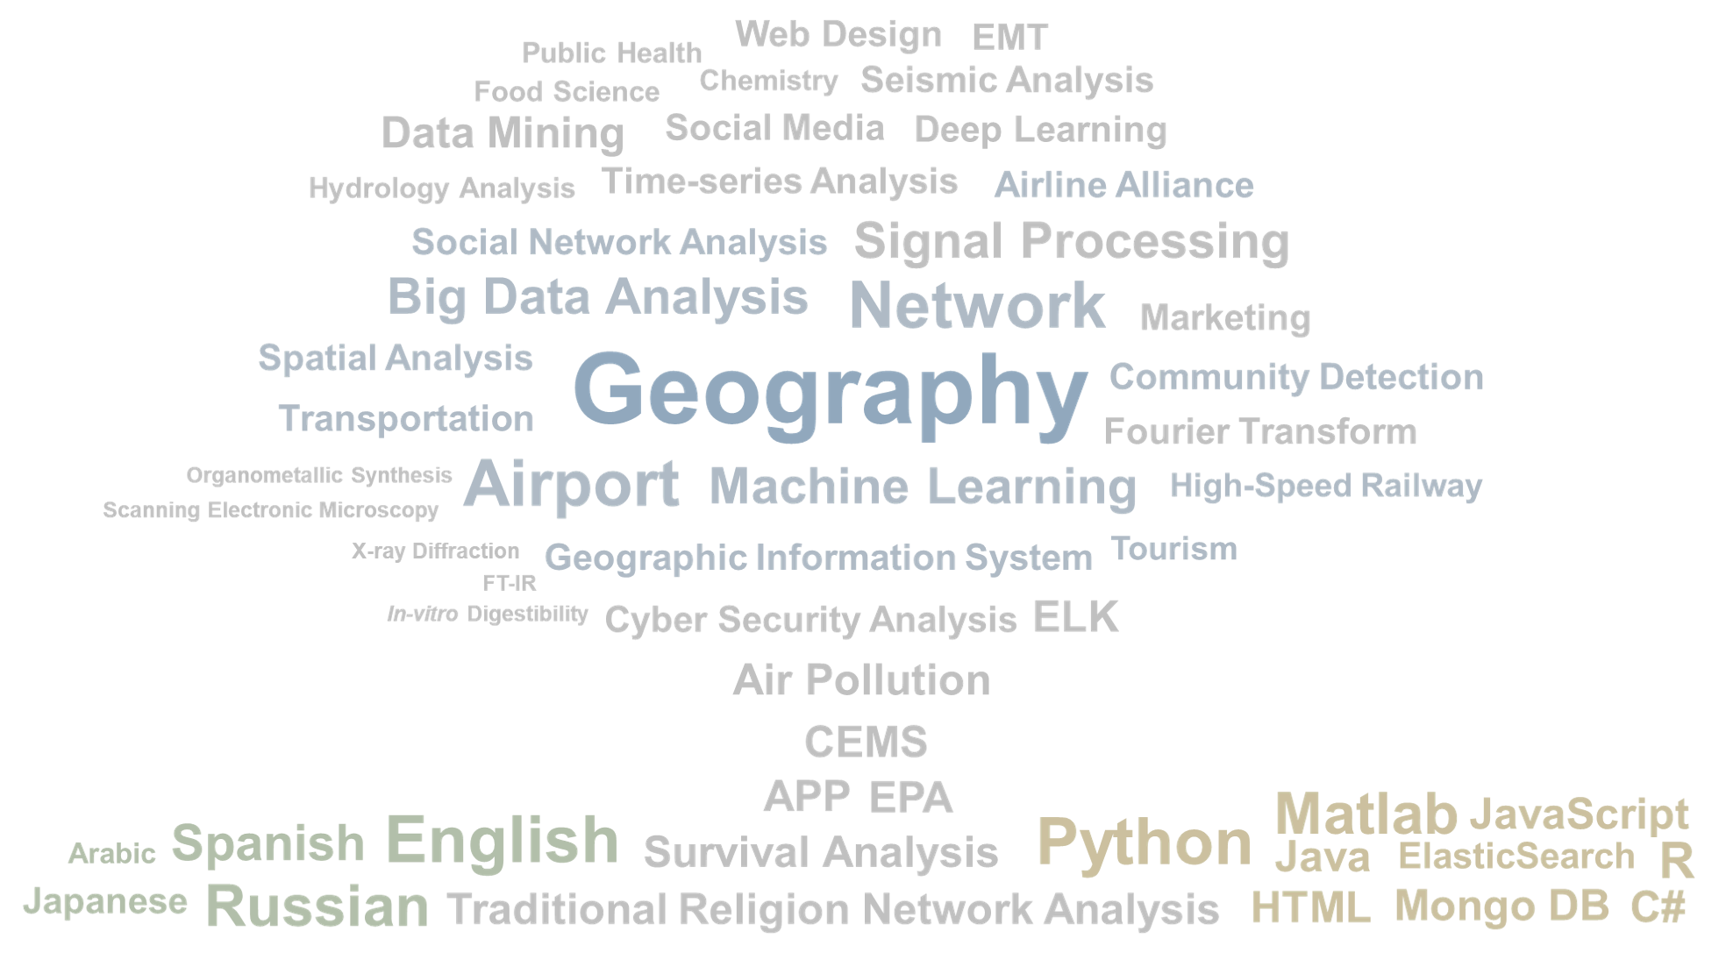
簡介
<Intro/>
研究專長
</Intro>

Slide 8
程式語言那麼多 | 如何提升求職競爭力
<Intro/>
Q1 程式語言學多不如學精?
Q2 到底學哪個程式語言比較好?
Q3 學哪個程式語言跟未來工作有關係?
Q4 如何在學生時期累積求職競爭力?
Q5 這堂課可以帶給我們甚麼新知?
</Intro>

Slide 9
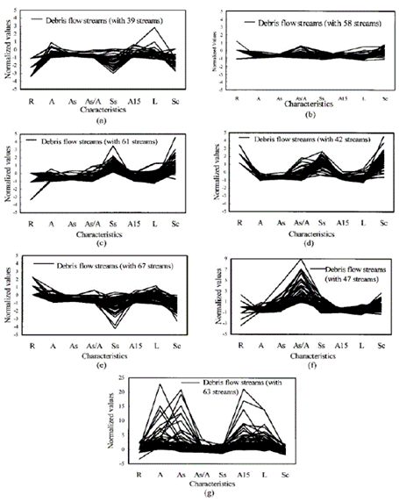
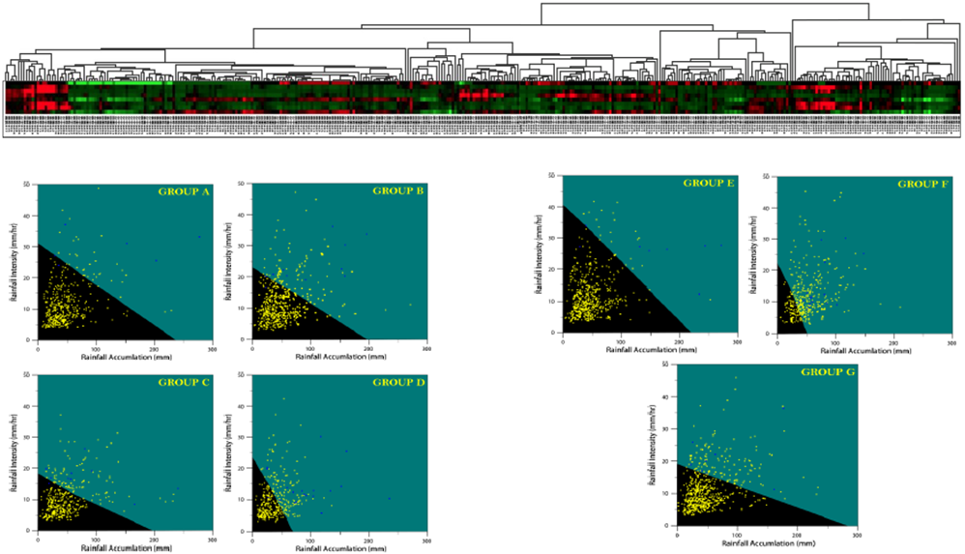
Yuan-Fang Tsai, Chun-Hsiang Chan, Keng-Han Lin, Wen-Ray Su, Jinn-Chyi Chen (2017, Jun). New debris flow critical rainfall line setting via cluster analysis and support vector machine after the Chi-Chi huge earthquake. 2017 13th International Conference on Natural Computation, Fuzzy Systems and Knowledge Discovery (ICNC-FSKD) (EI). 970-975.
Debris Flow Disaster | Part 1 |
Bachelor Thesis | Department of Social and Regional Development | National Taipei University of Education
Gap/ Objectives: The Chi-Chi huge earthquake occurred in Taiwan in 1999 and it changed the critical rainfall line of debris flow streams; therefore, how to establish a new critical rainfall line for each debris flow stream with a limited data becomes a vital issue. This study conducted family competition genetic algorithm and support vector machine to establish the critical rainfall line.

Slide 10
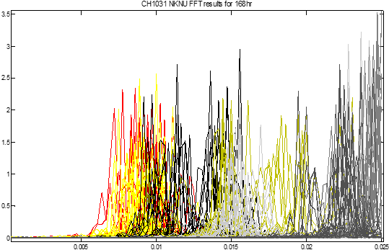
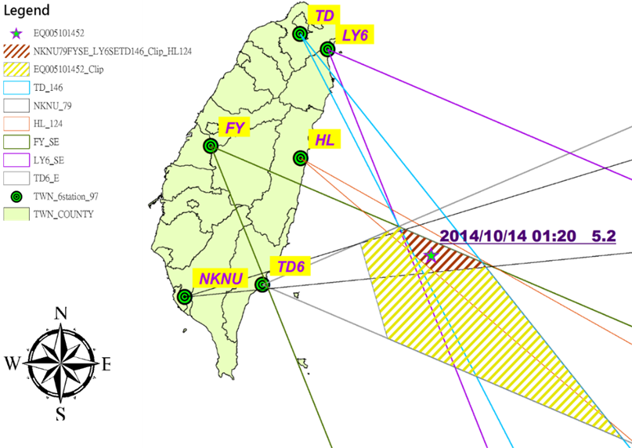
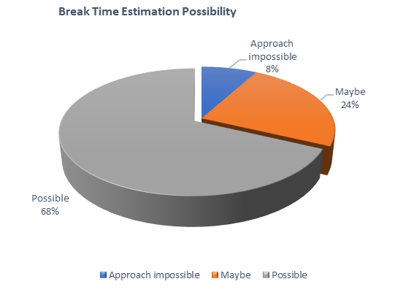
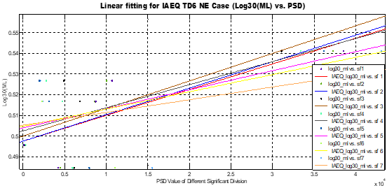
Chun-Hsiang Chan (2015). Applying Ultra Low Frequency Remote Sensing Techniques in the Earthquake Precursor Analysis — Using Taiwan as an Example, Dissertation in Department of Geography, National Taiwan University, 1-176.
Seismic Precursor | Part 2 |
Master Thesis | Department of Geography | National Taiwan University
Gap/ Objectives : Taiwan is suffered from earthquake disasters; however, state-of-art only performed case study and empirical equation to depict seismic precursor with a low spatial and temporal accuracy. This study deployed signal processing to capture the feature frequency band, identified the epicenter, estimated break time and magnitude of an earthquake events.

Slide 11



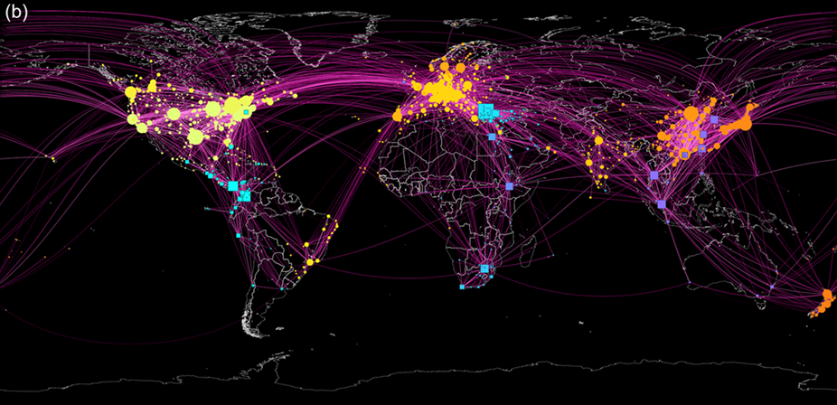
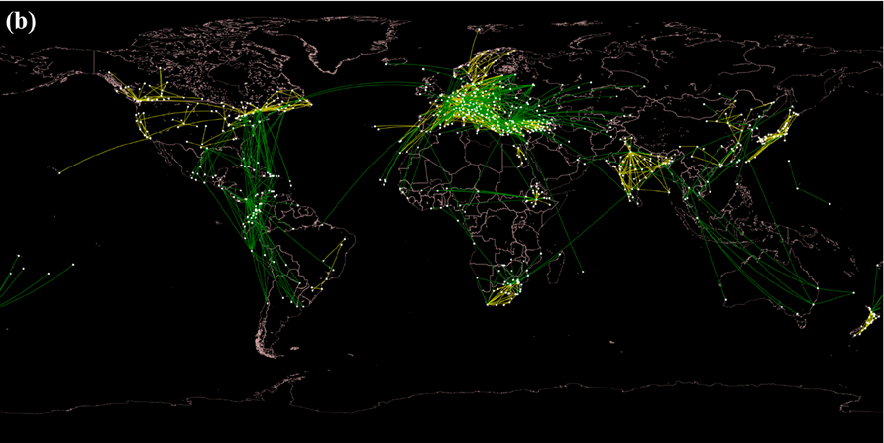
Chun-Hsiang Chan, Tzu-How Chu, Jiun-Huei Proty Wu, Tzai-Hung Wen (2021, Jan). Spatially Characterizing Major Airline Alliances: A Network Analysis. ISPRS International Journal of Geo-Information (IJGI). Vol.10(1), 38. https://doi.org/10.3390/ijgi10010038 (SCI IF: 2.239; Q3 31/50 in Geography)
Aviation Market | Part 3 |
Ph.D. Thesis | Department of Geography | National Taiwan University
Gap/ Objectives : Aviation market plays an important role in the accessibility between countries, consisting of airports and routes. However, market-related studies did not consider the connectivity and airport network-related studies neglected the market characteristics. Thus, this study is to utilize the concept of airport community to understand the spatial patterns of the market region in an airline alliance and characterize the differences between airline, including regions of collaboration, competition, and dominance.

Slide 12
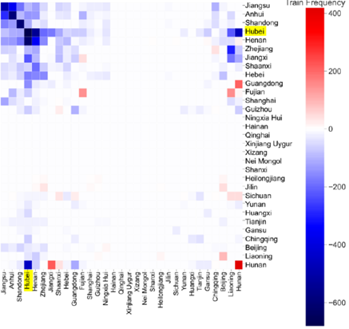
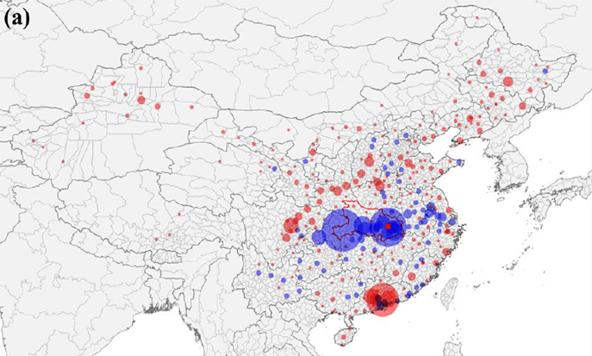
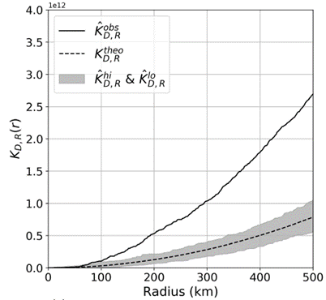
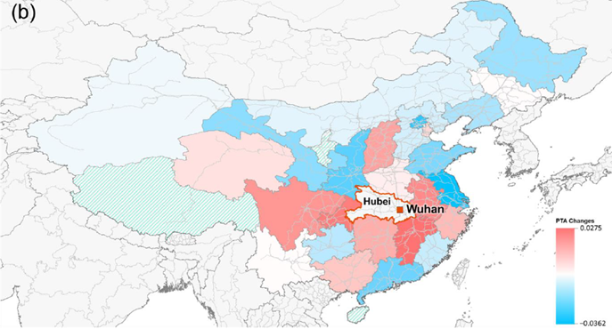
Chun-Hsiang Chan, Tzai-Hung Wen (2021). Revisiting the effects of high-speed railway transfers in the early COVID-19 cross-province transmission in China. International Journal of Environmental Research and Public Health. Vol.18(12), 6394. https://doi.org/10.3390/ijerph18126394 (SSCI IF: 2.849; Q1 32/171 in Public, Environmental & Occupational Health)
Epidemic Transmission | Part 4 |
MOST Project | Department of Geography | National Taiwan University
Gap/ Objectives : The possible reasons of a large number of confirmed cases concentrated in the neighboring provinces of Hubei have not been fully discussed after the Wuhan city lockdown. Therefore, this study aims to assess the changes in railway passenger transport on the early spatial transmission of COVID-19 in mainland China.

Slide 13
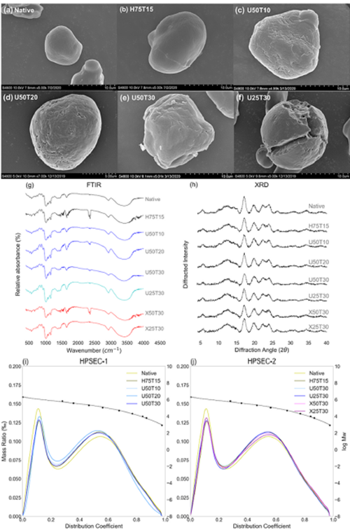
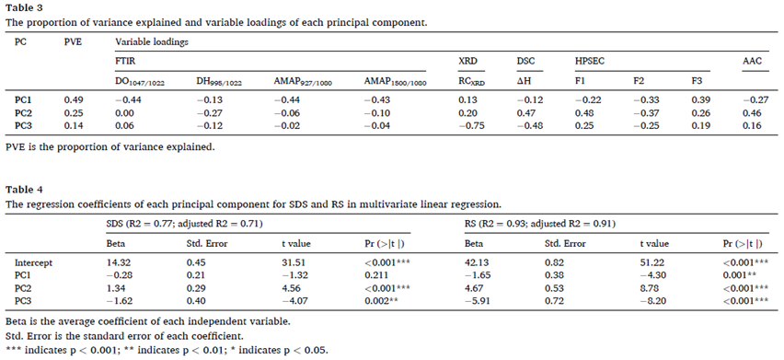
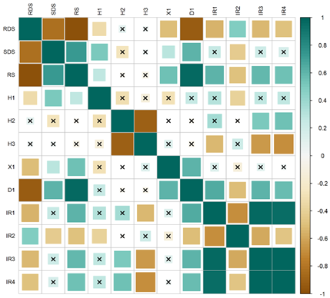
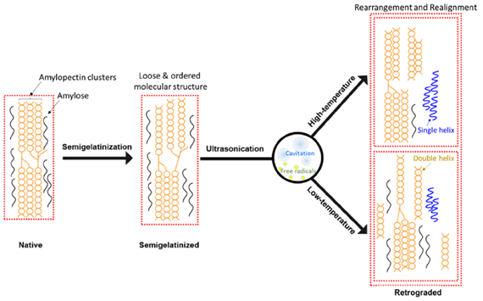
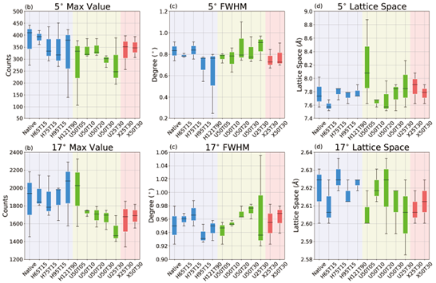
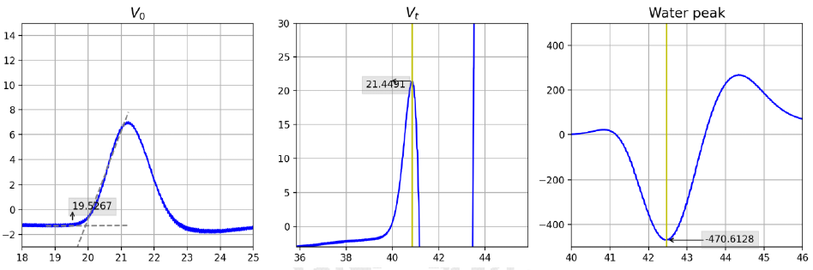
Chun-Hsiang Chan, Ri-Gui Wu, Yi-Yuan Shao (2021). The effects of ultrasonic treatment on physicochemical properties and in vitro digestibility of semigelatinized high amylose maize starch. Food Hydrocolloids. Vol.119, 106831. https://doi.org/10.1016/j.foodhyd.2021.106831 (SCI IF: 9.147; Q1 4/71 in Applied Chemistry; Q1 5/139 in Food Science & Technology)
Starch - in vitro digestibility | Part 5 |
Master Thesis | Department of Food Science, Nutrition, and Nutraceutical Biotechnology | Shih Chien University

Slide 14
課程大綱
<Syllabus/>
W1 0922 Introduction
W2 0929 Review: C Variables & Loop
W3 1006 Review: C Condition & Array
W4 1013 Function - Basic
W5 1020 Function - Advance
W6 1027 Pointer I
W7 1103 Pointer II
W8 1110 Pointer III
W9 1117 Mid-term Exam
W10 1124 Final Project Introduction & Brainstorming
W11 1201 File Processing
W12 1208 String I*
W13 1215 String II*
W14 1222 Dynamic memory allocation
W15 1229 Struct and Final Project Preparation*
W16 0105 Final Project Presentation
W17 0112 Holiday
有標註*為進度報告的週次
</Syllabus>

Slide 15
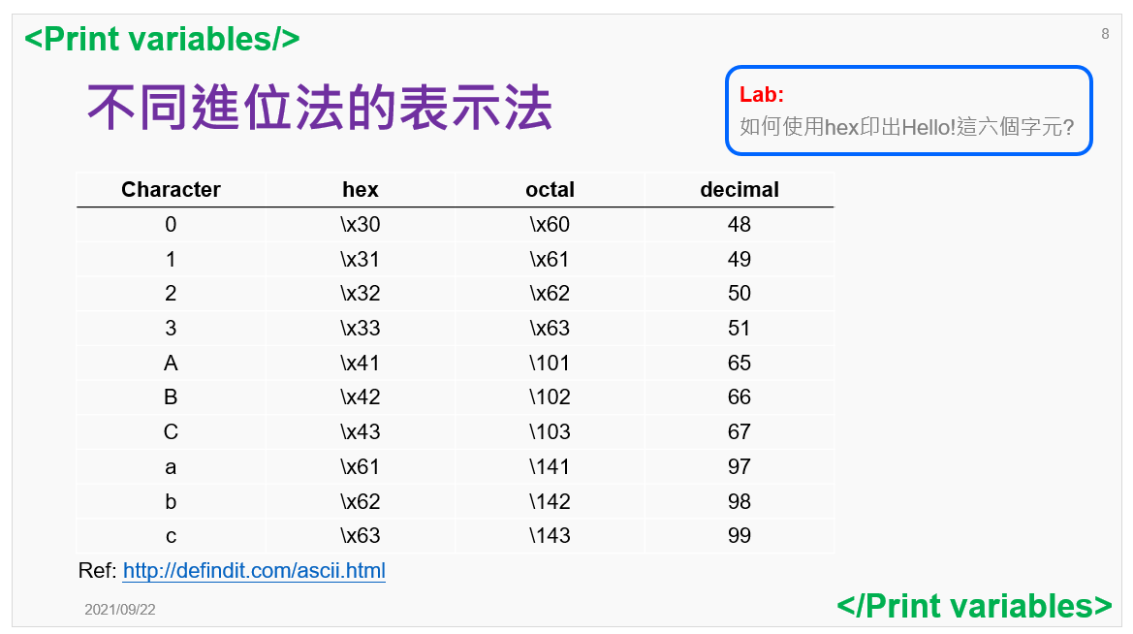
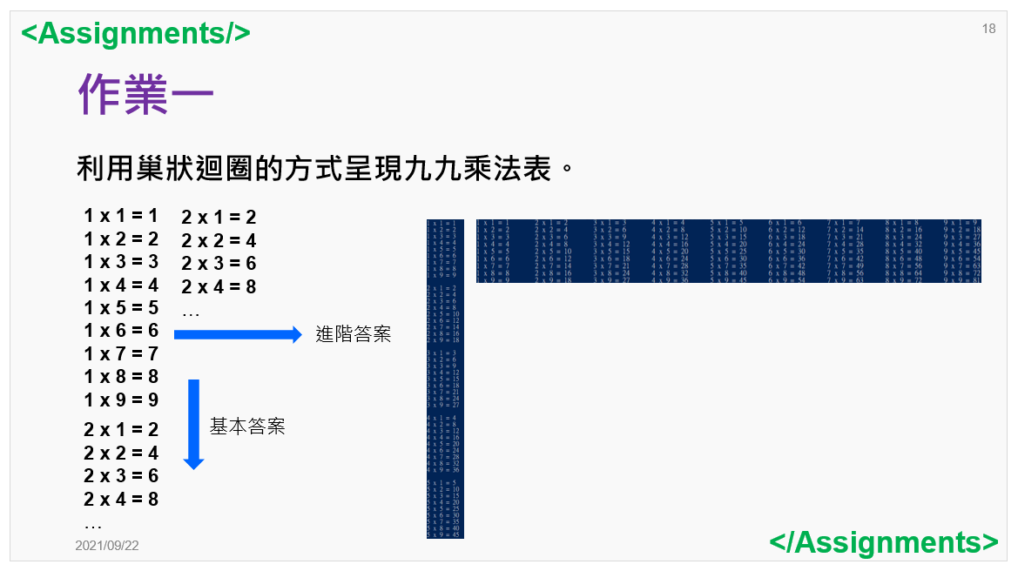
課程進行方式
<Syllabus/>
課堂練習的部分會希望各位可以在整理成一個檔，下課前我會去尋每一位的程式碼的執行結果作為出席之用。
課堂小練習
每周都會有一至兩個作業，最好的話是希望各位可以在課堂後練習時間完成，如果遇到比較難或是寫比較久的作業，可以帶回家繼續做。原則上，deadline為隔周上課前一天23:59上傳至作業區。遲交一天，分數打8折，兩天64折。
作業
* 目前預計上課前一周會將課程投影片上傳。
* 期中考的進行方式視課程況狀作彈性調整。
</Syllabus>

Slide 16
期末專題
<Syllabus/>
期中考後作業loading會降低，為了讓大家有充足的時間做期末專題之用或是課堂討論。
人數為3-5人，全班大約分為10組，不過視情況而定。
期末成果發表前會有三次的進度報告: 主題發想、初步成果(完整程式架構 + 60%左右的撰寫進度)、完整成果(90%撰寫進度)
期末口頭發表，每組15分鐘，必須包含: code review & live demo!
</Syllabus>

Slide 17
課程評量方式
<Evaluation/>
出席: 課堂練習作為出席標準
課堂表現: 10 %
作業: 30 % (希望可以在課堂內完成!)
期中考: 20 % (視情況彈性調整)
專題製作: 30 %
- 主題製作完整性: 30%
- 難度: 30%
- 報告呈現: 20%
- 互評成績: 20% [小組: 50%；組間: 50%]
Learning by Doing
Project
Assignment
Mid-term Exam
</Evaluation>

